Slide 1
LAB 6 SHIFT REGISTERS
BY: JOEL STEEPHAN

Slide 2
WHY DID I DO THIS?
Well I did this lab because most lab code will have their synthesis pass and you will be like wow the code works. But the implementation does not work and you just go nuts over what is right?
Well that is what I did in this lab. Most of the code worked but I could not get the constraints file to work.

Slide 3
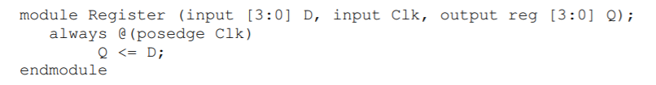
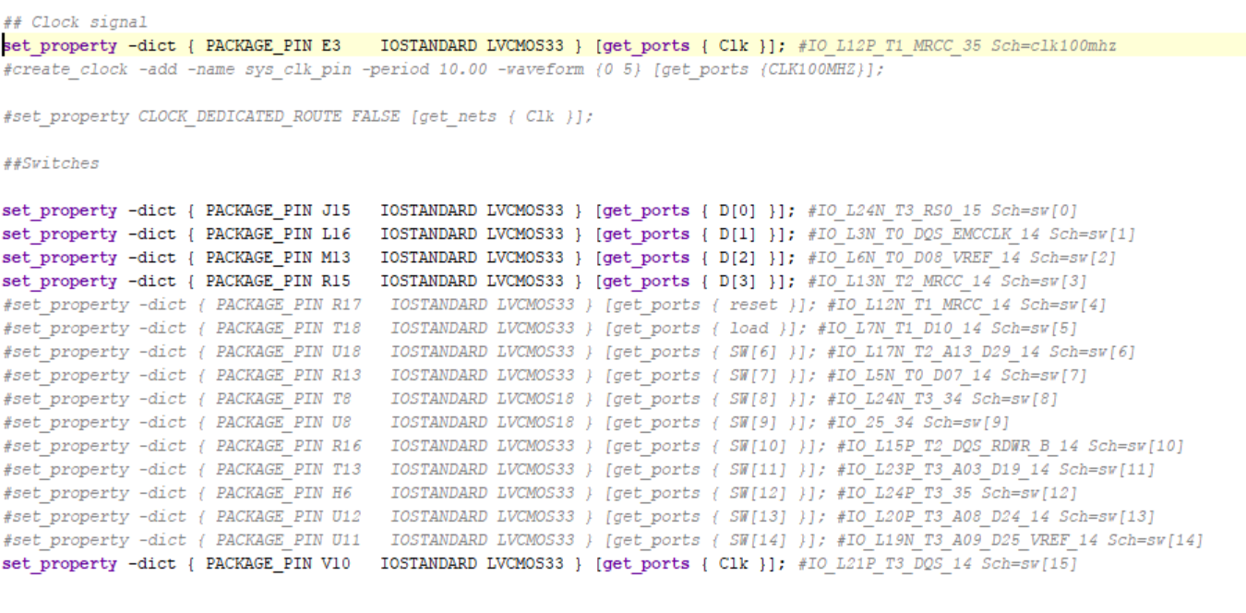
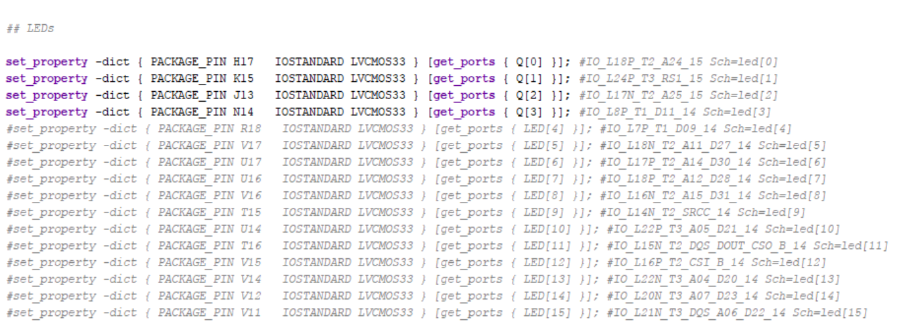
REGISTERS

Slide 4
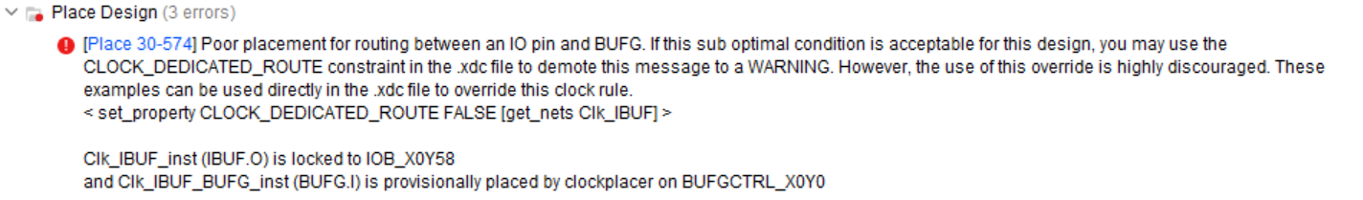
REGISTERS
The program ran synthesis successfully
There was an error in implementation

Slide 5
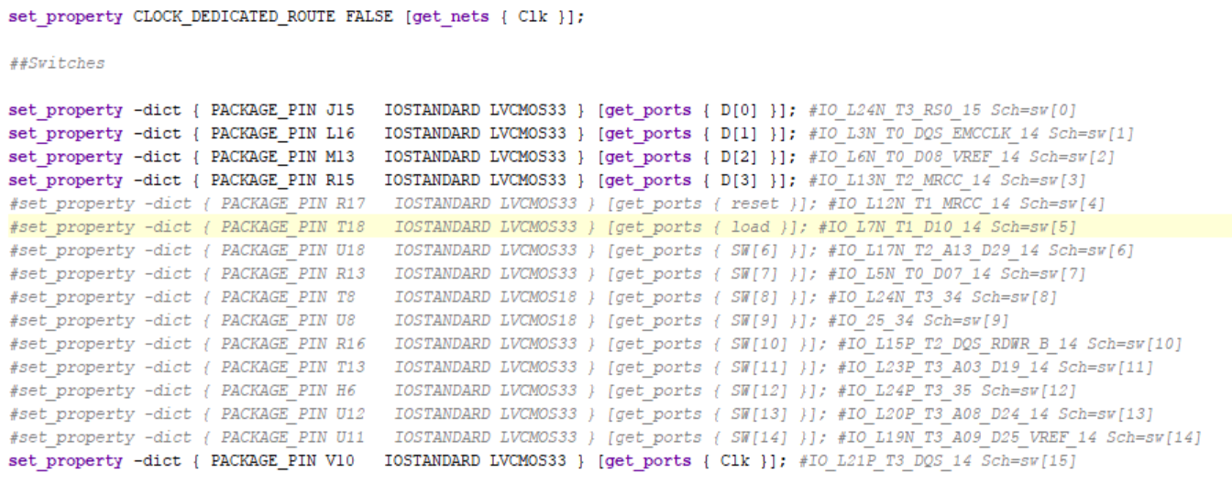
REGISTERS
Implementation usually means there is a error in the constraints file so I look at the error message and added what they wanted me to add.

Slide 6
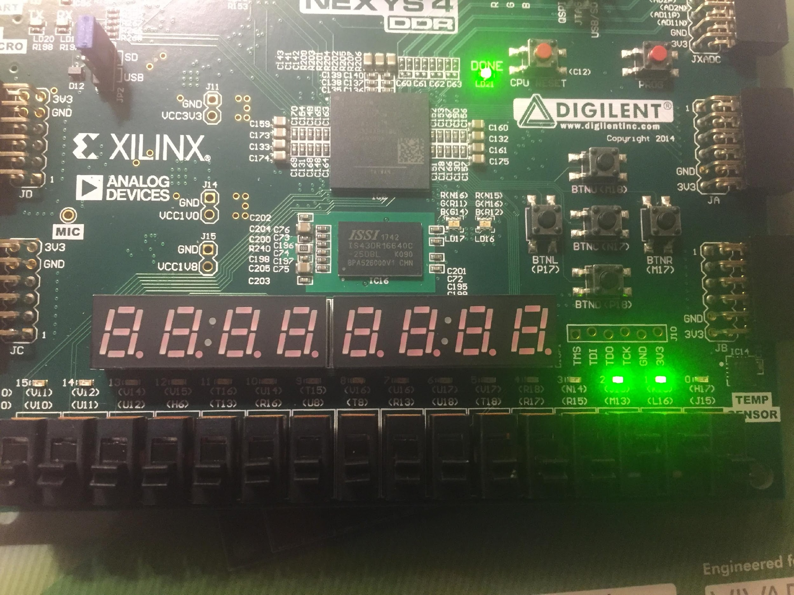
REGISTER
It works, the implementation ran and the NexysDDR lights turned on.

Slide 7
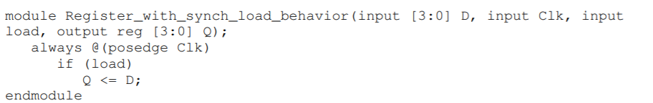
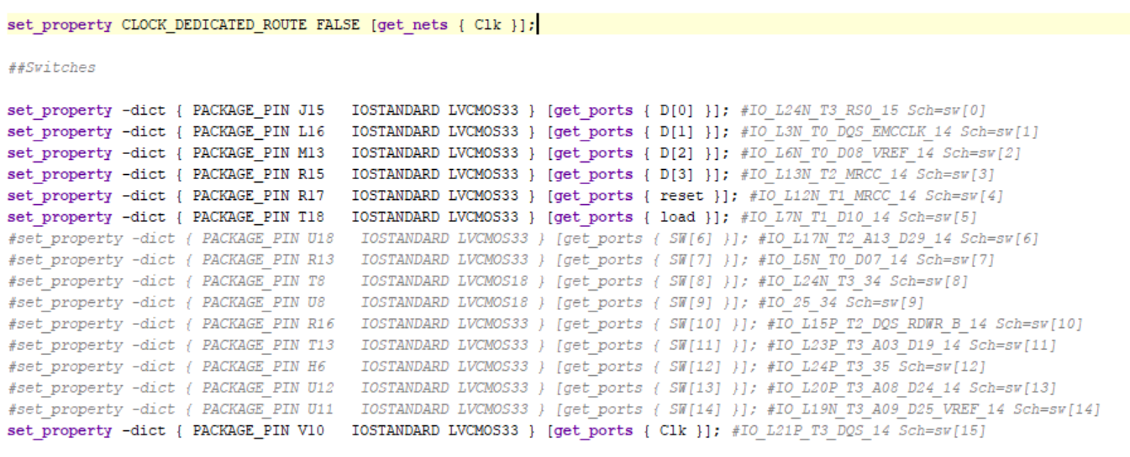
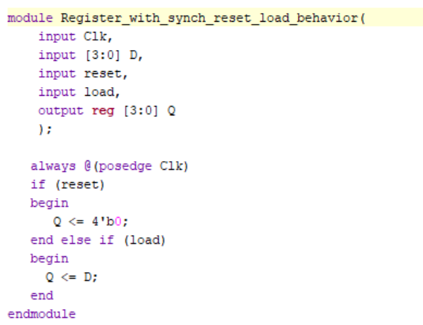
REGISTER

Slide 8
REGISTER
I had to create a register with a set input into the register code earlier.
I failed
I did not know what to do to run set and its functionality
So it would fail synthesis
So I looked at Xilinx code and hooked up a constraints file to it.

Slide 9
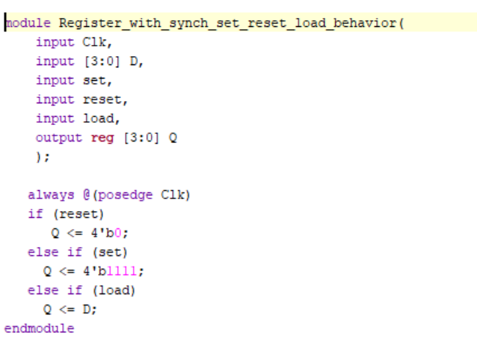
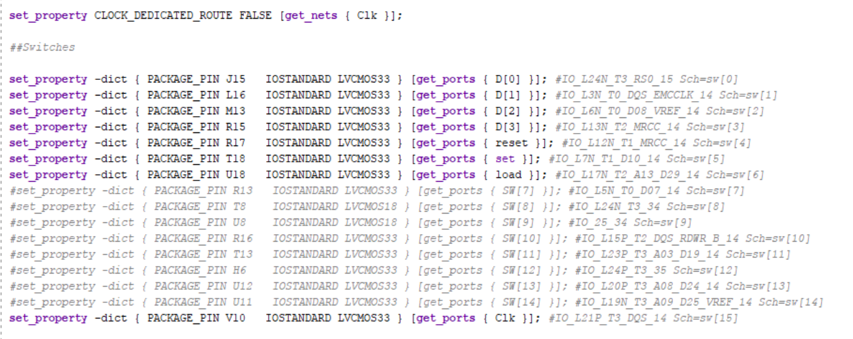
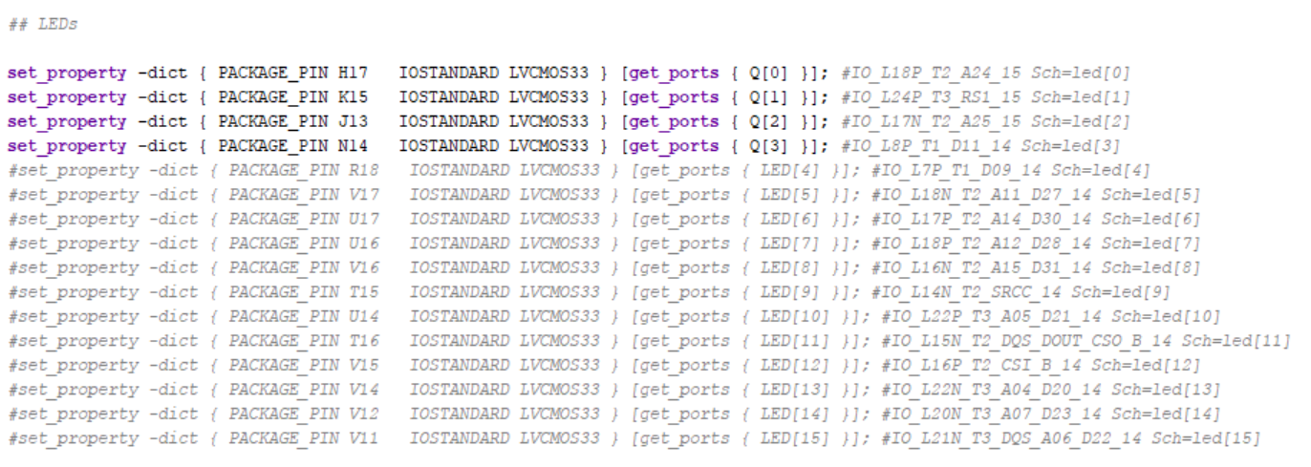
REGISTER

Slide 10
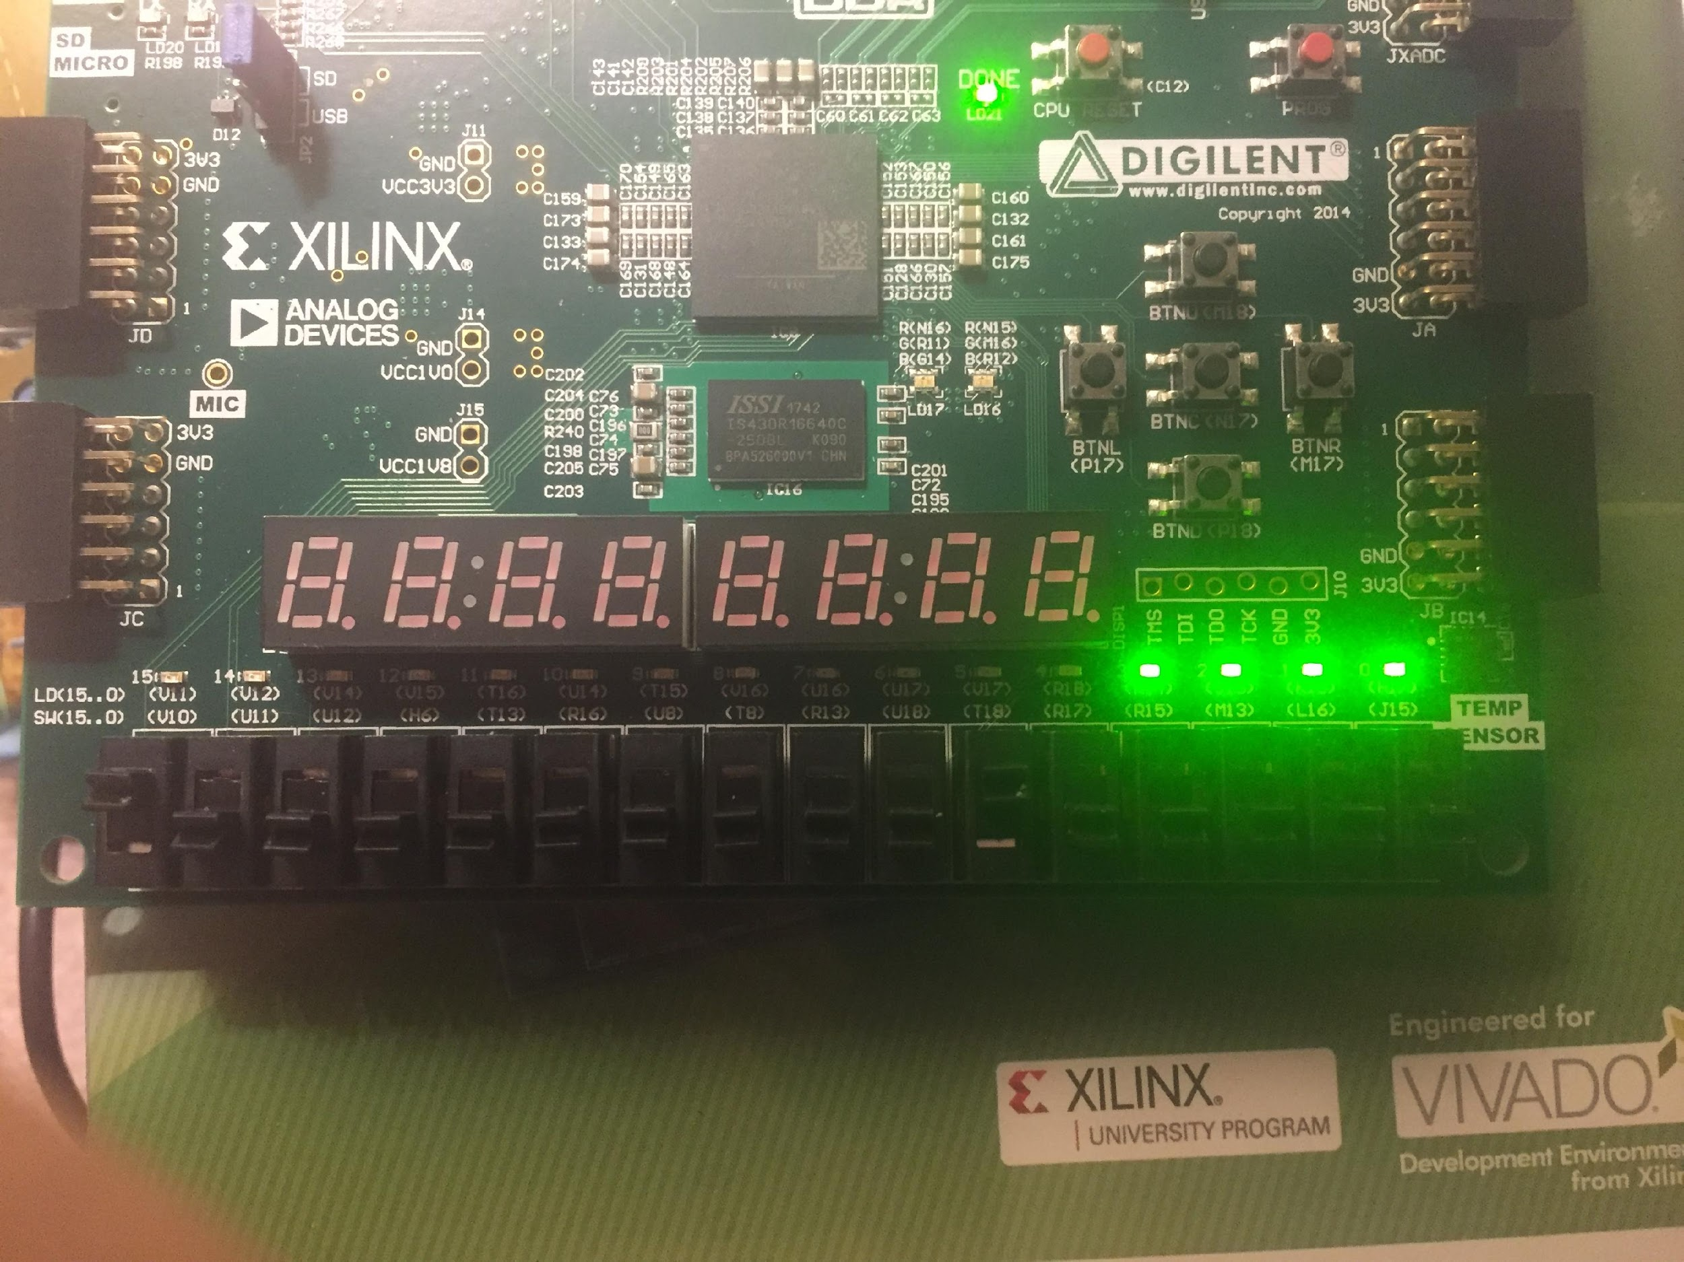
REGISTER
It works and lights turn on NexyDDR
I overcomplicated the code for set I tried to do it as a assign command but here they just put it in the always code as a else if.

Slide 11
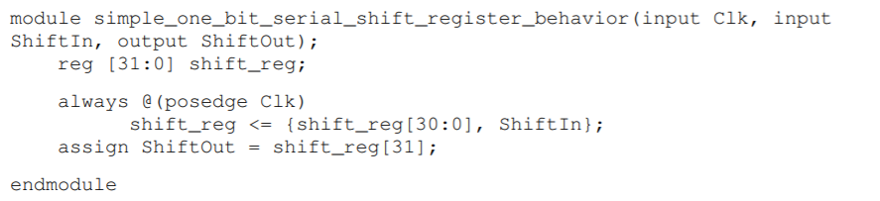
SHIFT
I realized my constraints file and the Nexys does not have 32 bits
So I just changed the code to 4 bits

Slide 12
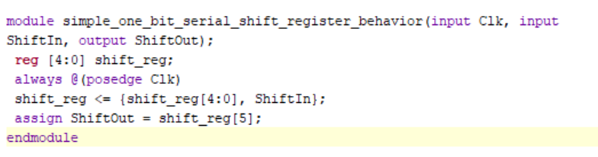
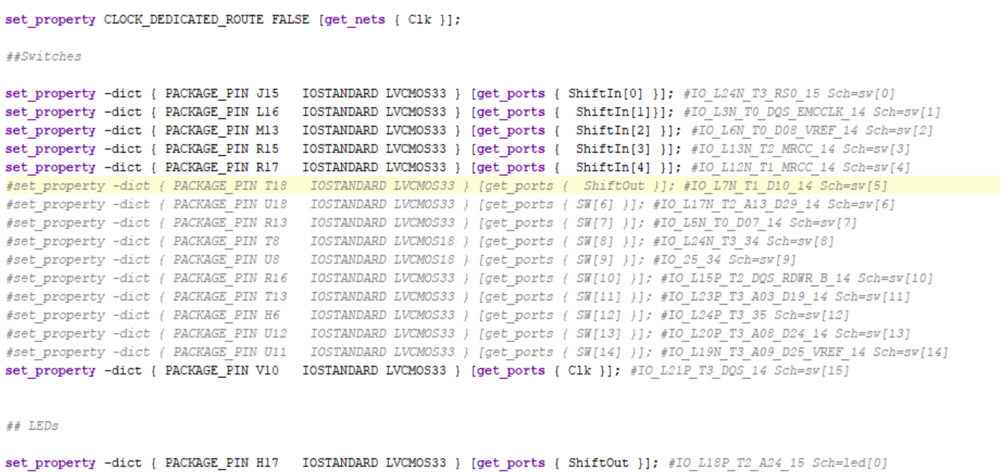
SHIFT

Slide 13
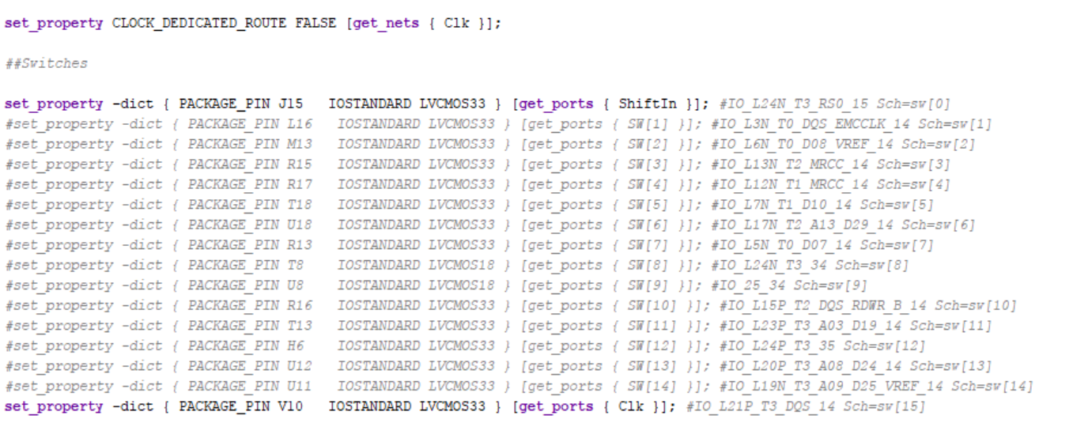
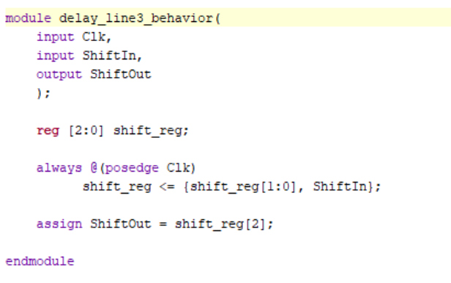
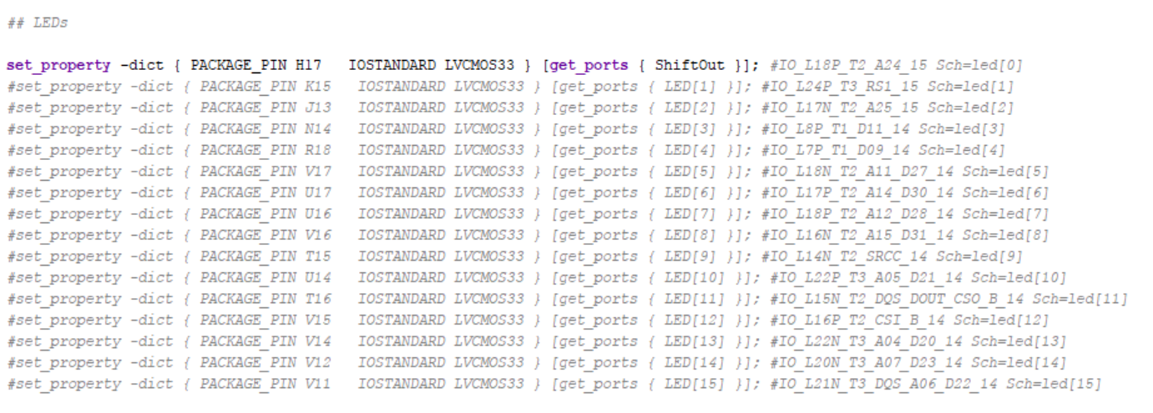
SHIFT
Everything would run but in my Nexys none of the lights would turn on.
So I looked at the Xlinx code for this.

Slide 14
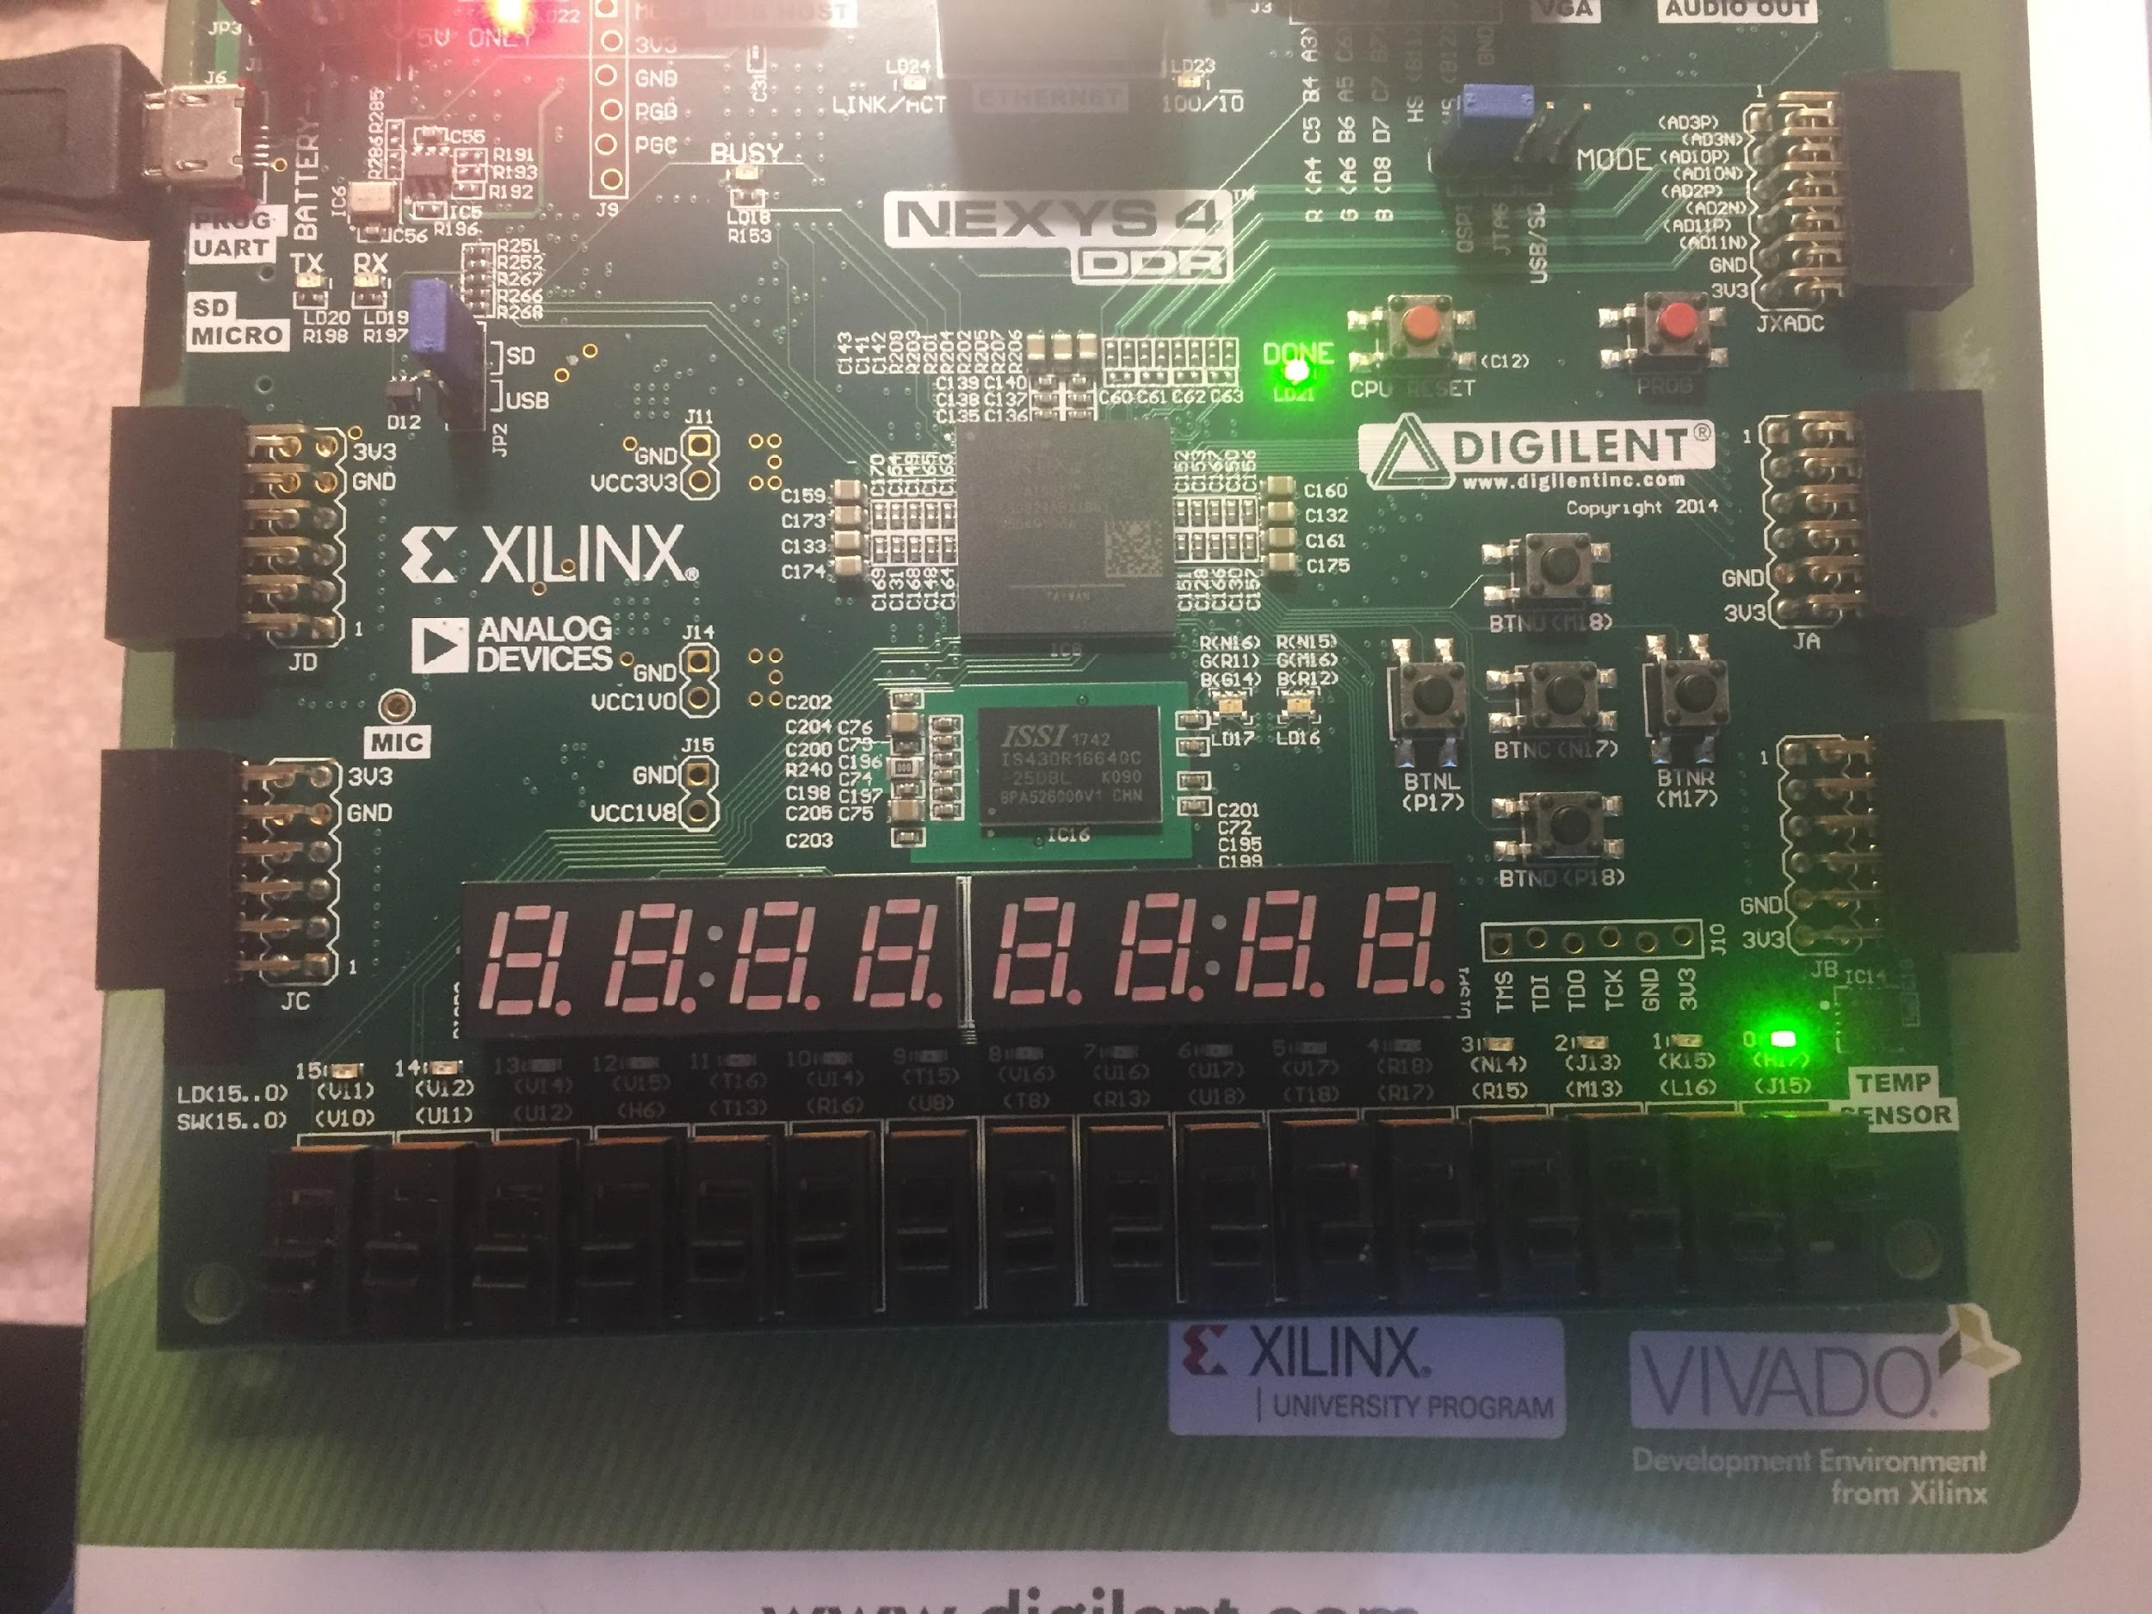
SHIFT
It worked
I had to fist enable shiftin and then switch the clock 3 times for the shiftout to turn on

Slide 15
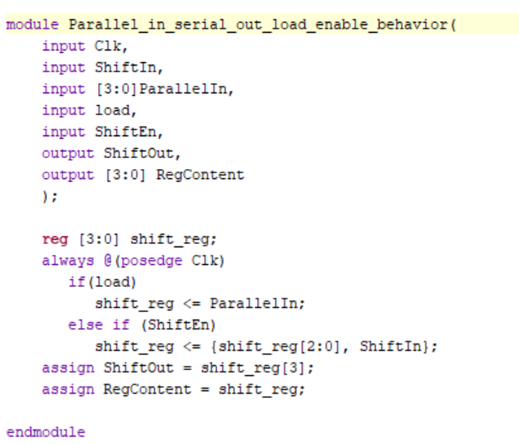
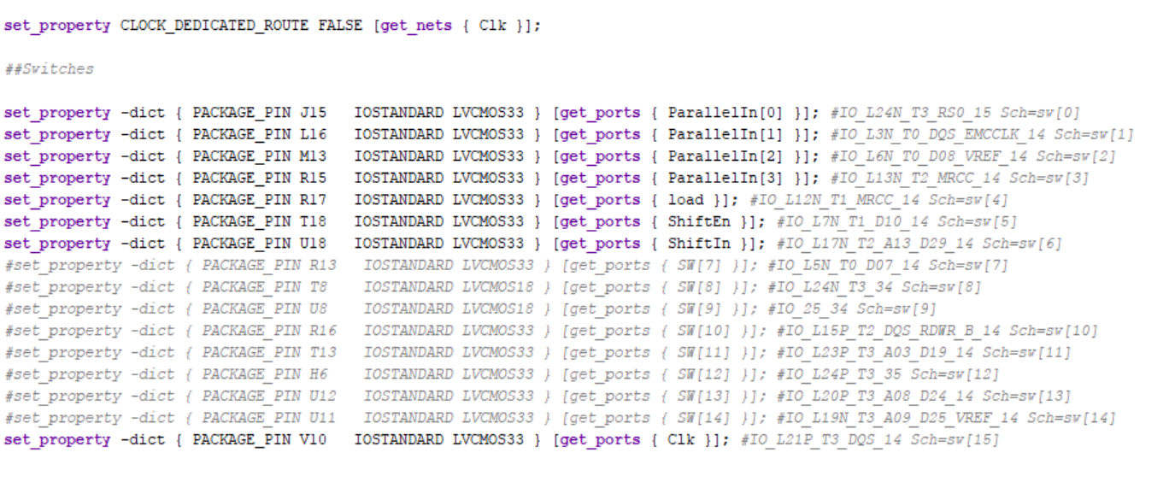
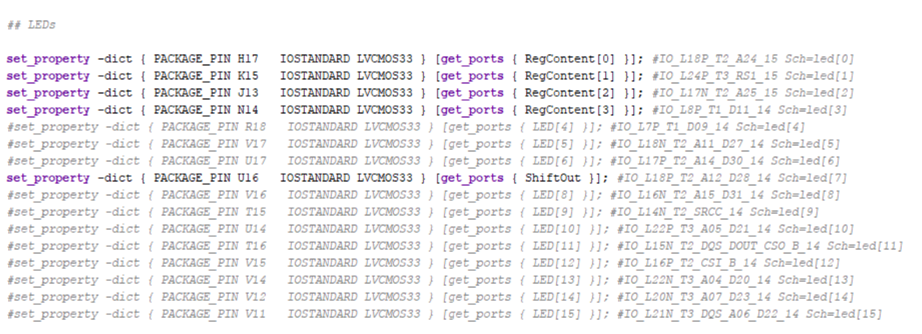
PARALLEL SHIFT REGISTER

Slide 16
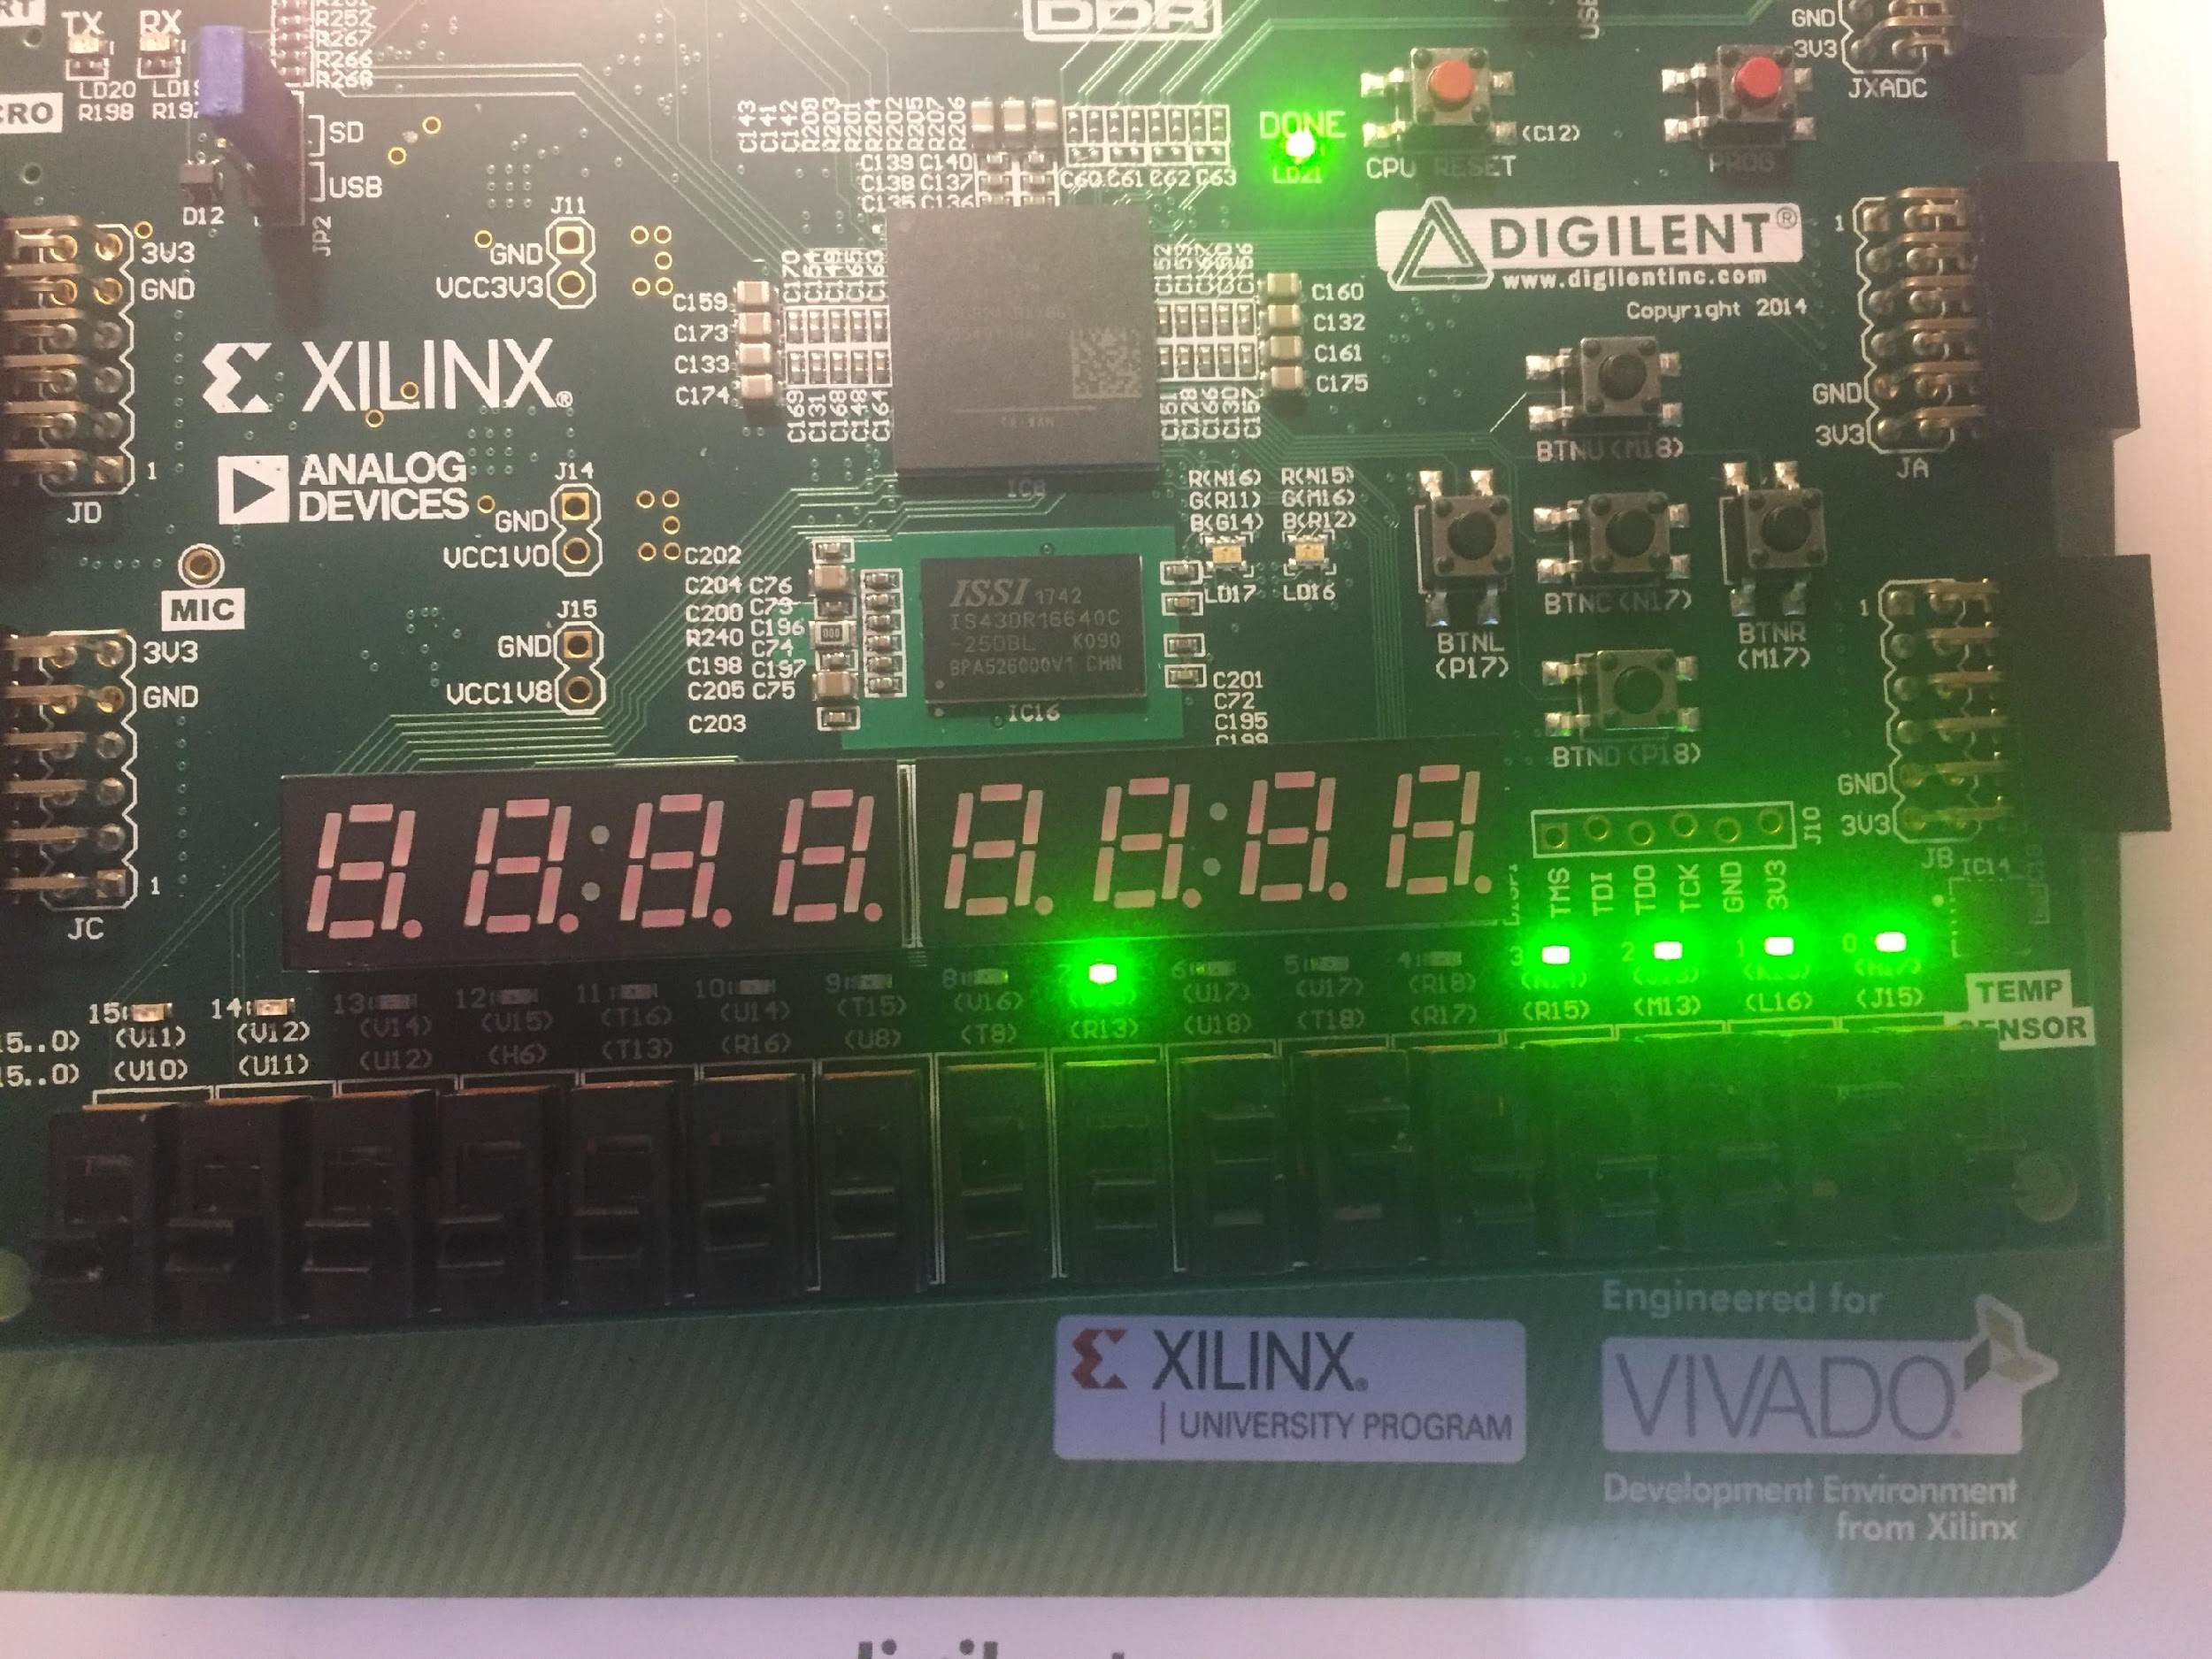
PARALLEL SHIFT REGISTER
This one worked first time.
First you had to load the parallelin and then when you switch shift the lights shift left and when you have shiften and shift in turned on at the same time then it will shift left to turn all the lights on.

Slide 17
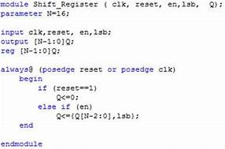
4-BIT SERIAL SHIFT REGISTER
I had to create my own
I don’t know how to do one so I searched online what it looks like.
It did not help
Xilinx told me the inputs and outputs so I worked from there.

Slide 18
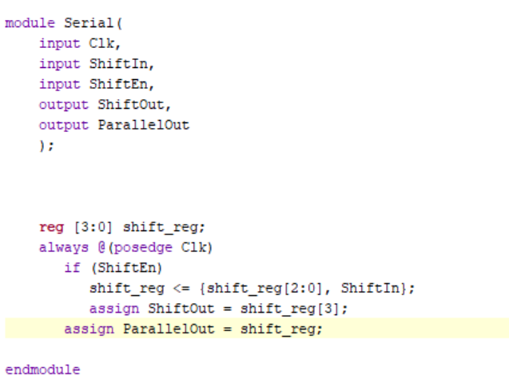
4-BIT SERIAL SHIFT REGISTER
I based my code of the parallel circuit but with the inputs and outputs Xilinx gave me:
Input: Clk, ShiftIn, ShiftEn
Output: ShiftOut, ParallelOut
The synthesis worked.

Slide 19
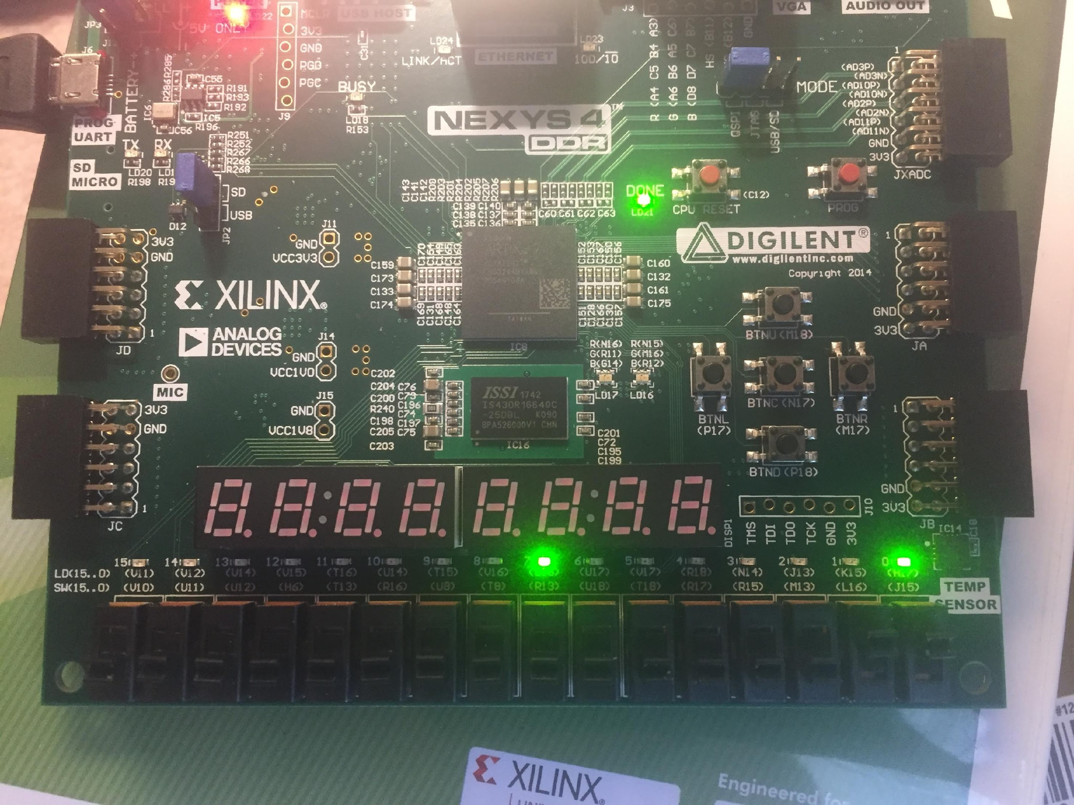
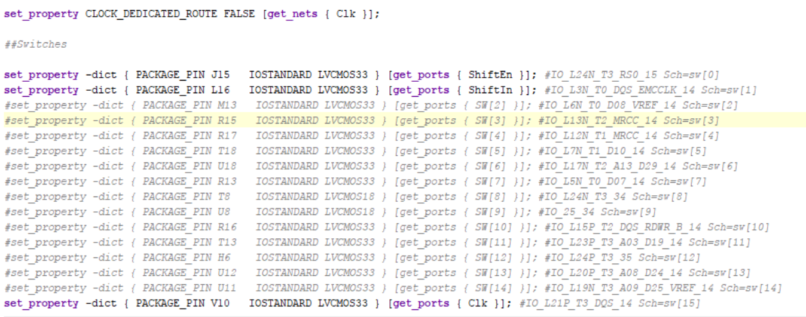
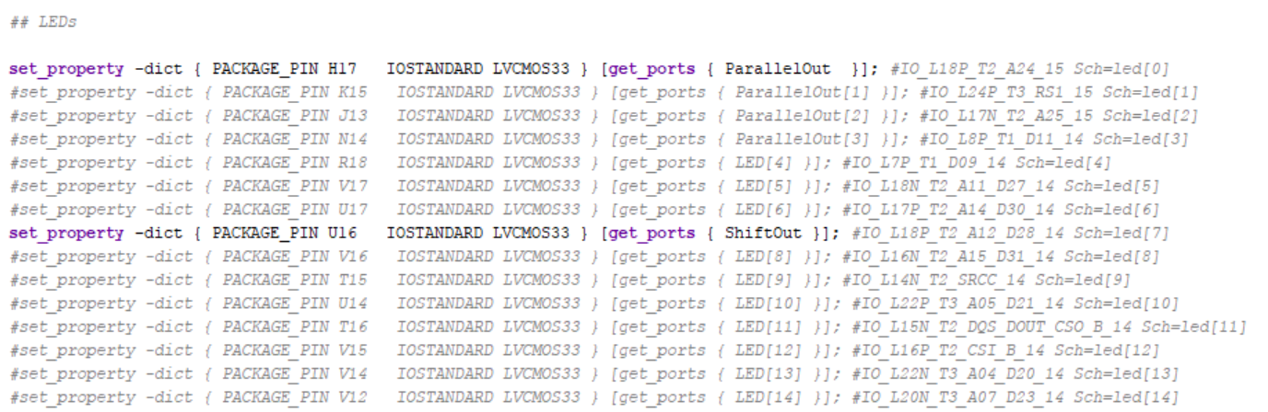
4-BIT SERIAL SHIFT REGISTER
So I hooked up a constraints file to it.
Everything worked.

Slide 20
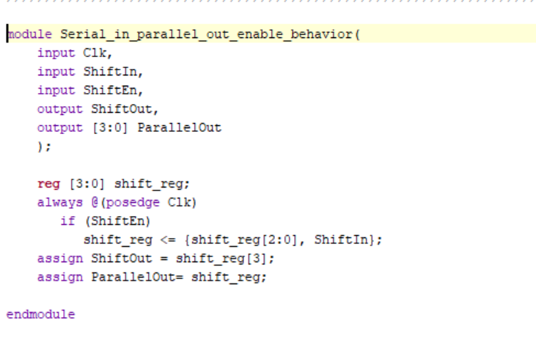
4-BIT SERIAL SHIFT REGISTER
When I compare mine to the Xilinx code I was really close.

Slide 21
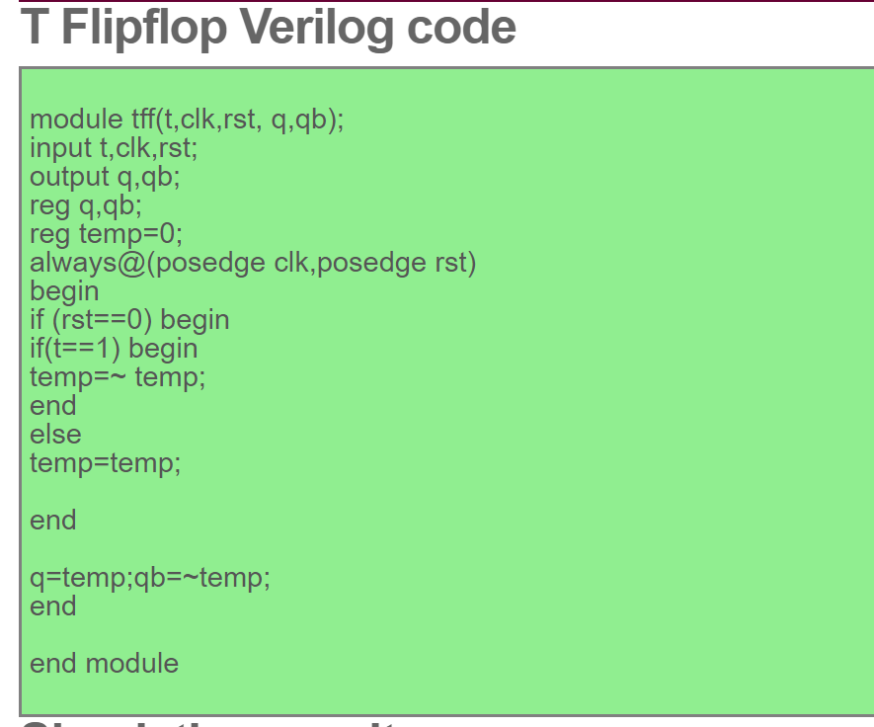
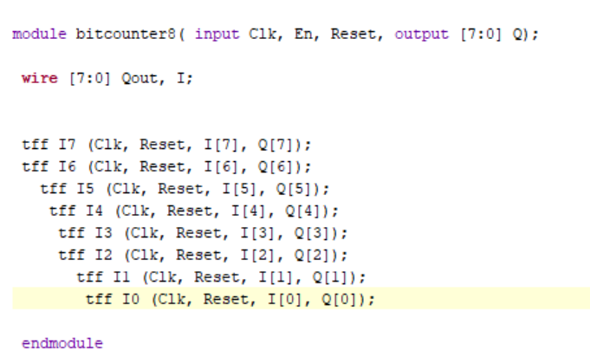
8-BIT T-FLIP FLOP COUNTER
Now I had to make my 8-bit counter by hand.
I found t-flip flop code online so I used that
Now I have to build a top level module for the 8bit counter.
My program ran synthesis successfully.

Slide 22
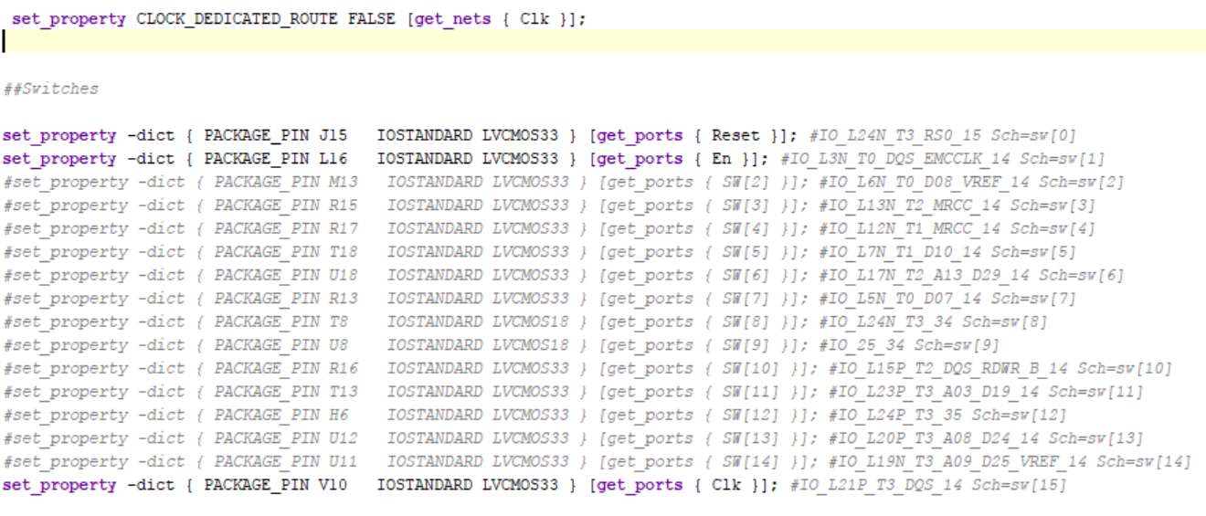
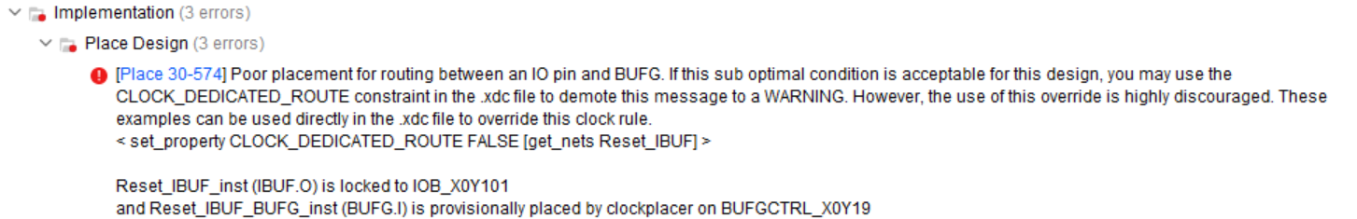
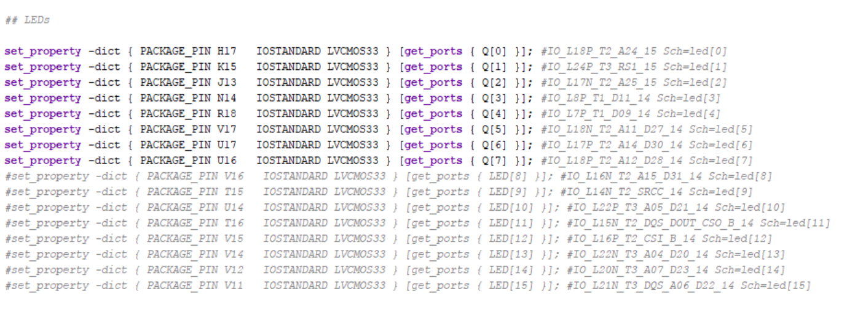
8-BIT T-FLIP FLOP COUNTER
Now I had to make a constraints file
The implementation failed.

Slide 23
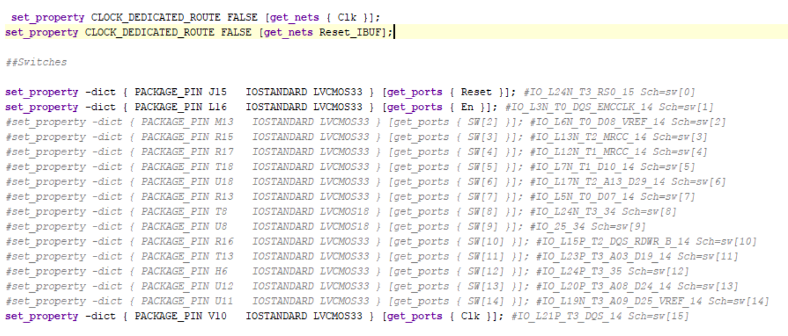
8-BIT T-FLIP FLOP COUNTER
This error is the same as the clock on before so I added what it told me too
It worked the bitstream ran and lights turned on my Nexys but I don’t think this is what this program should do.
The program will turn all the lights on and sometimes go off when I do reset and dim sometimes.

Slide 24
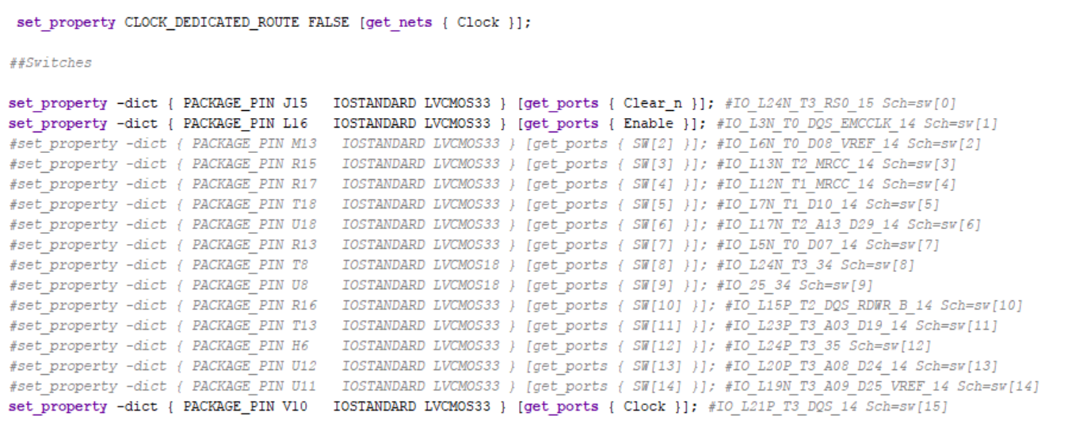
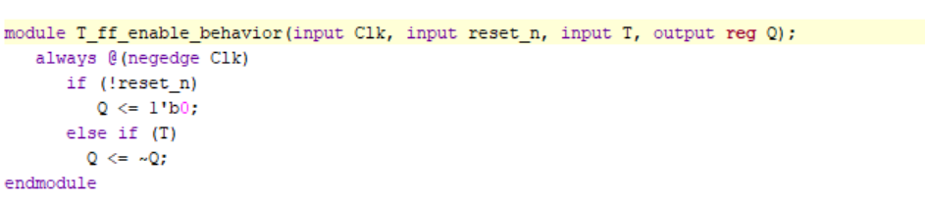
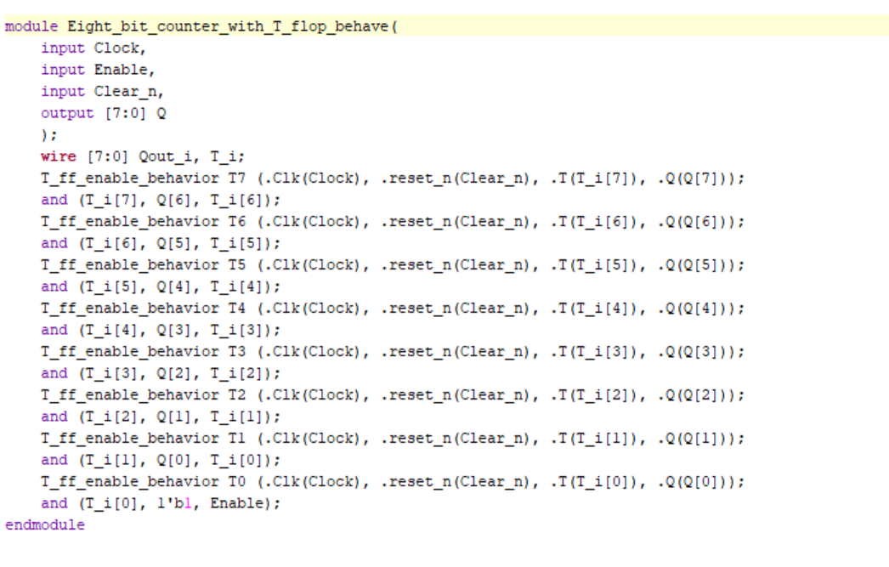

8-BIT T-FLIP FLOP COUNTER
So I compared my program with the one Xilinx made.
I was off by alot

Slide 25
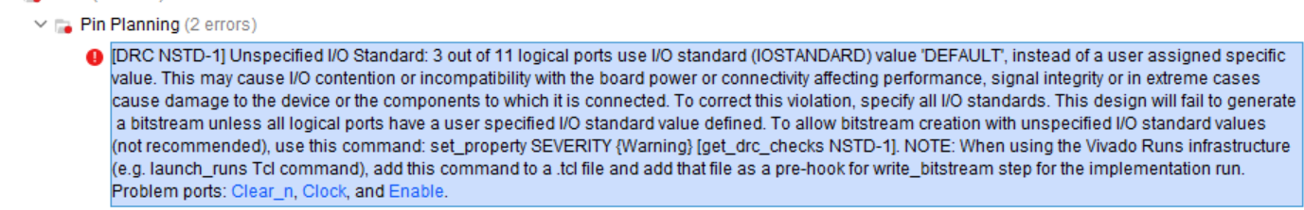
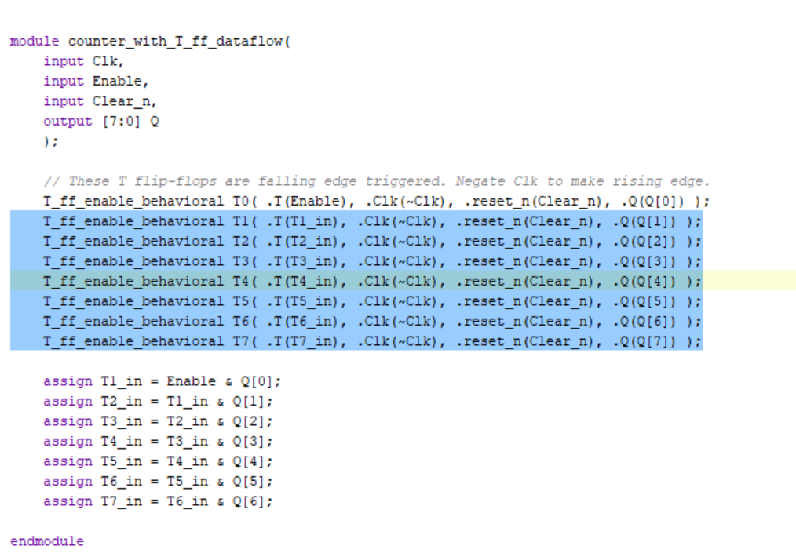
8-BIT T-FLIP FLOP COUNTER
When I ran the program the bitream came with a error message.
So I used Brendan Curleys program to compare with mine

Slide 26
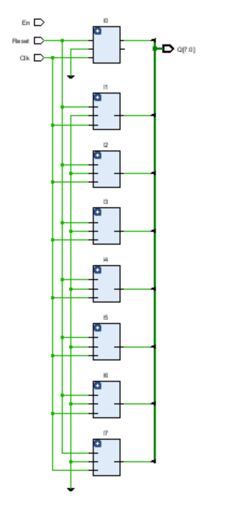
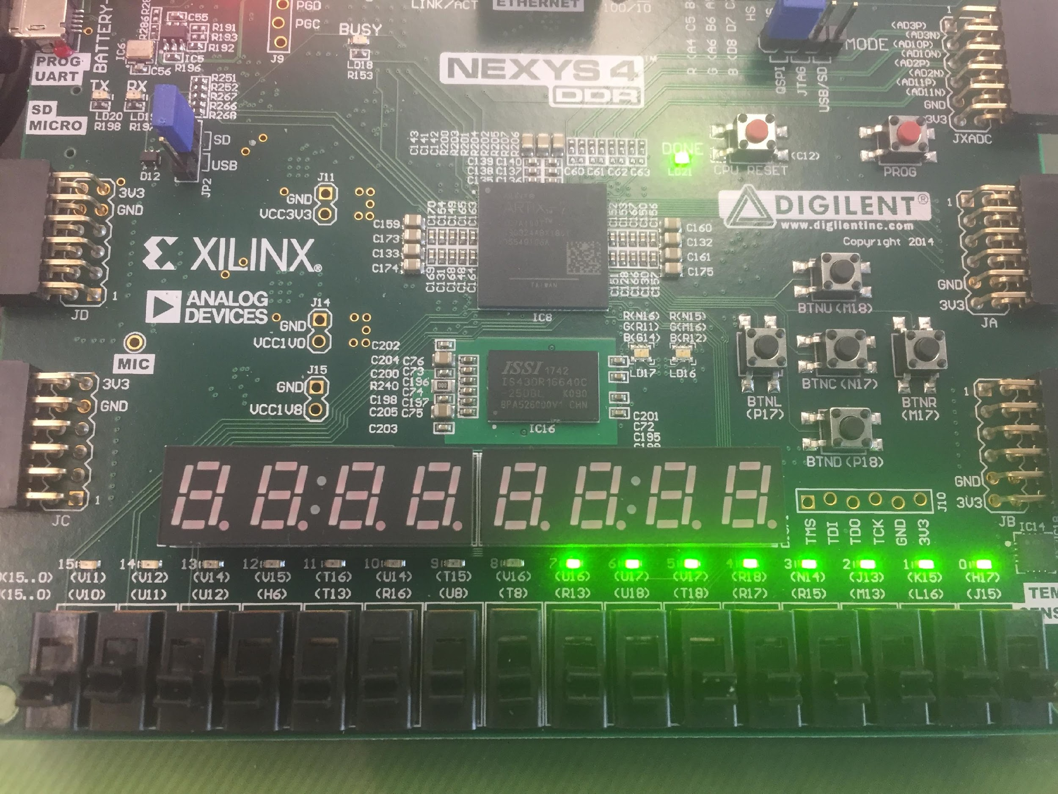
8-BIT T-FLIP FLOP COUNTER
Bcurleys program works and the Nexys just counts using the led
The problem with mine is all my T flip flops are hooked up together.
And enable is connected to nothing
Rant:
It would be easier if we can get the Verilog code and bitstream just from the logism picture

Slide 27
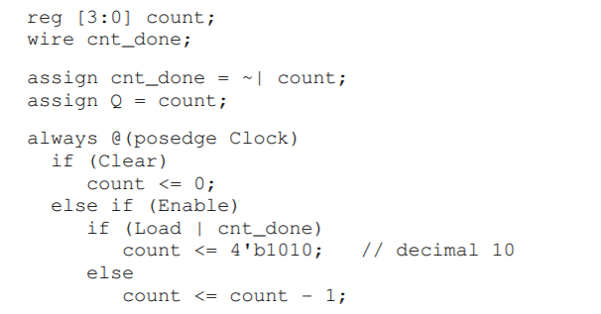
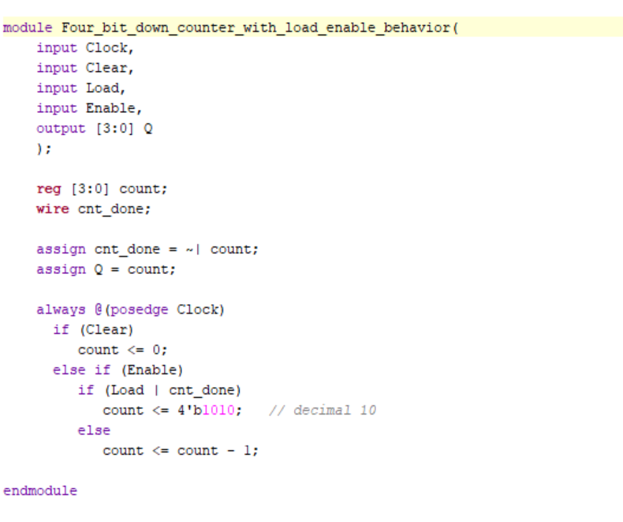
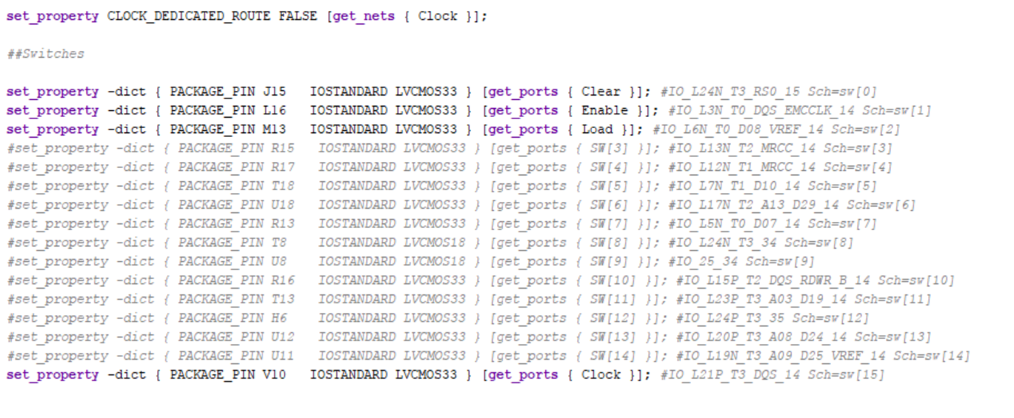
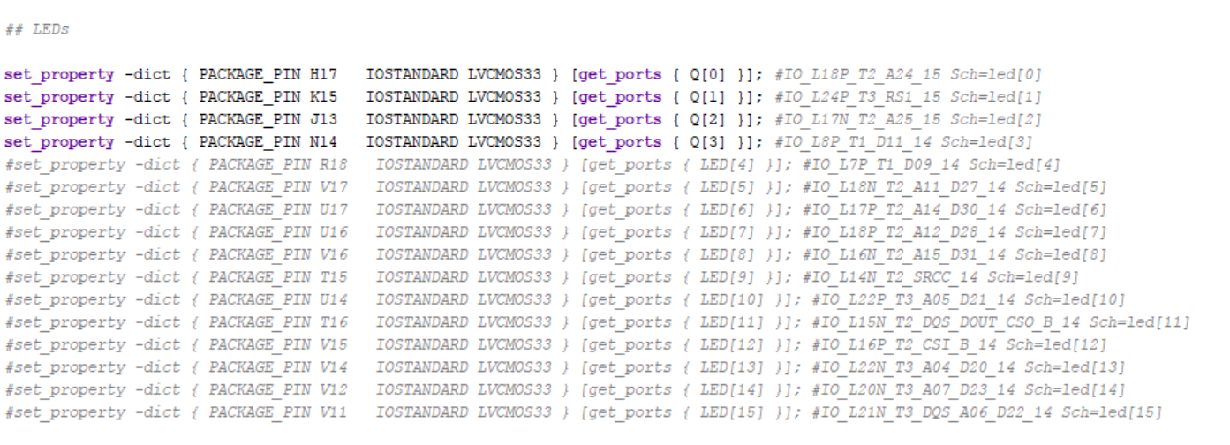
4-BIT COUNTER
So now I got to hook up inputs and outputs to this code.
Input: Clock, Clear, Enable, Load
Output: Q[3:0]
So now I hooked it to a constraints file.

Slide 28
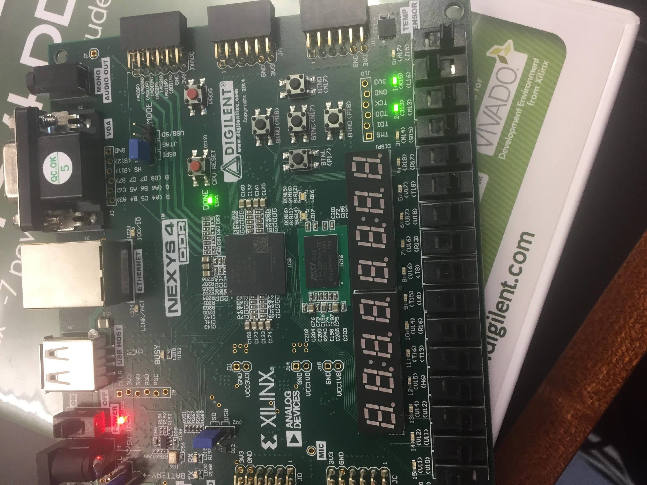
4-BIT COUNTER
It worked
The Nexys counted backwards and load loaded to beginning and clear cleared it.

Slide 29

THE END

